Slide 1
GALLERY
Focus
Up
Restart
Focus
Down
QPI
Exit

Slide 2


Slide 3
Live View
Gallery
Exit

Slide 4
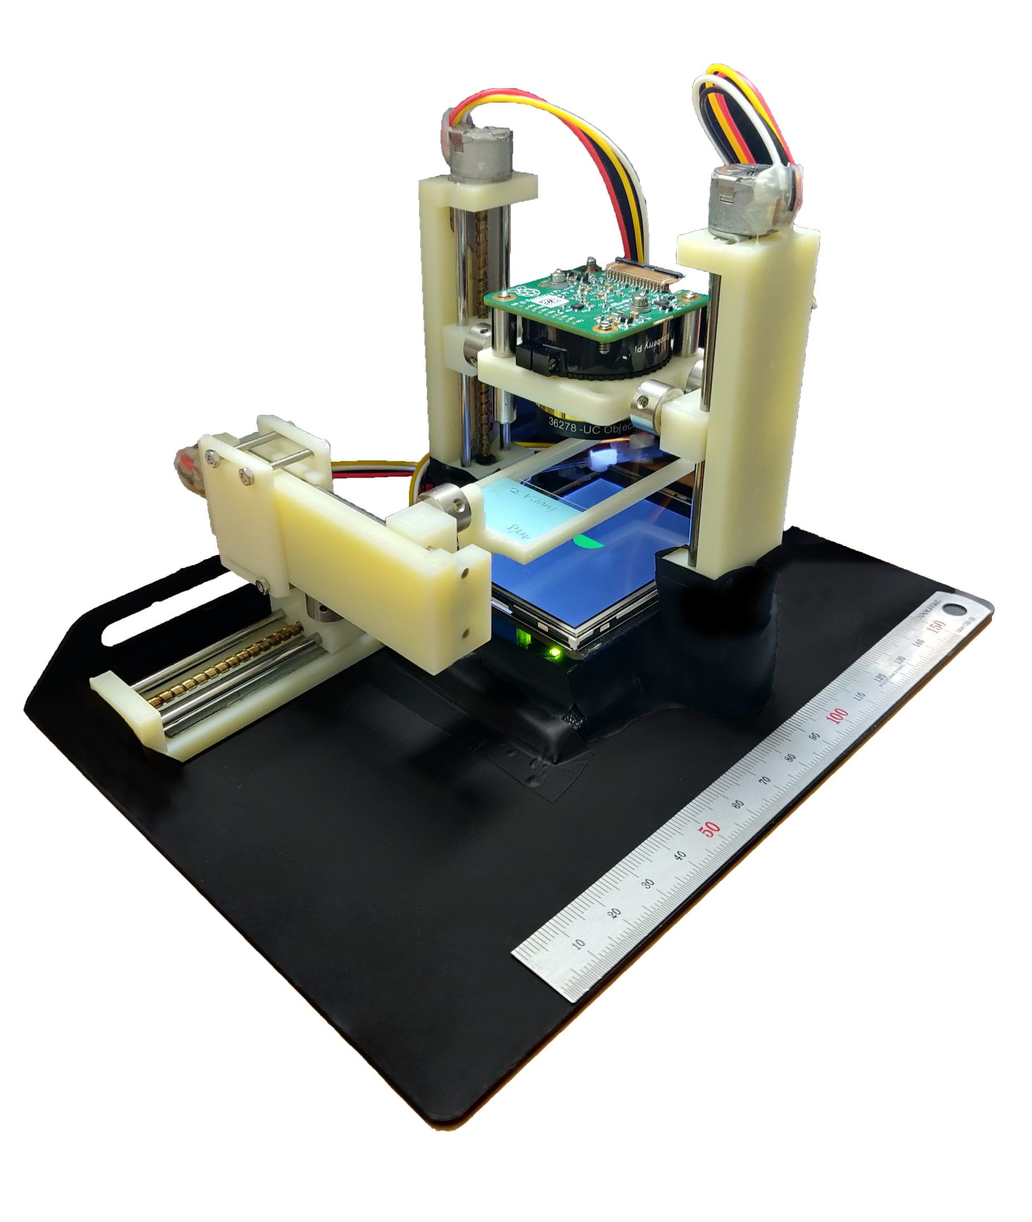

Slide 5
Focus
Up
Focus
Down
QPI
Restart
Gallery

Slide 6
Gallery
Focus
Down
Focus
Up

